Slide 1
Stock Price Prediction System

Slide 2
Scope Definition
Objectives
Investment in a stock market can be profitable if one can predict correctly. Our software predicts future prices and graphically represent these.

Slide 3
Scope Definition
Description
Takes dynamic data on daily basis
Using past stock history predicts the price
Recommendation of investment

Slide 4

Scope Definition
Expected Outcome
Reliable prediction of stock prices
Recommendation of investment which can maximize profit.
Assumption
Availability of data in stock exchange website.
Stock Price will not fluctuate drastically.

Slide 5
Scope Definition
Risk
Security risk of user information database
Wrong prediction may lead to company defamation
Out of scope
This software won’t manage buying and selling of stock.

Slide 6
Flow Chart

Slide 7
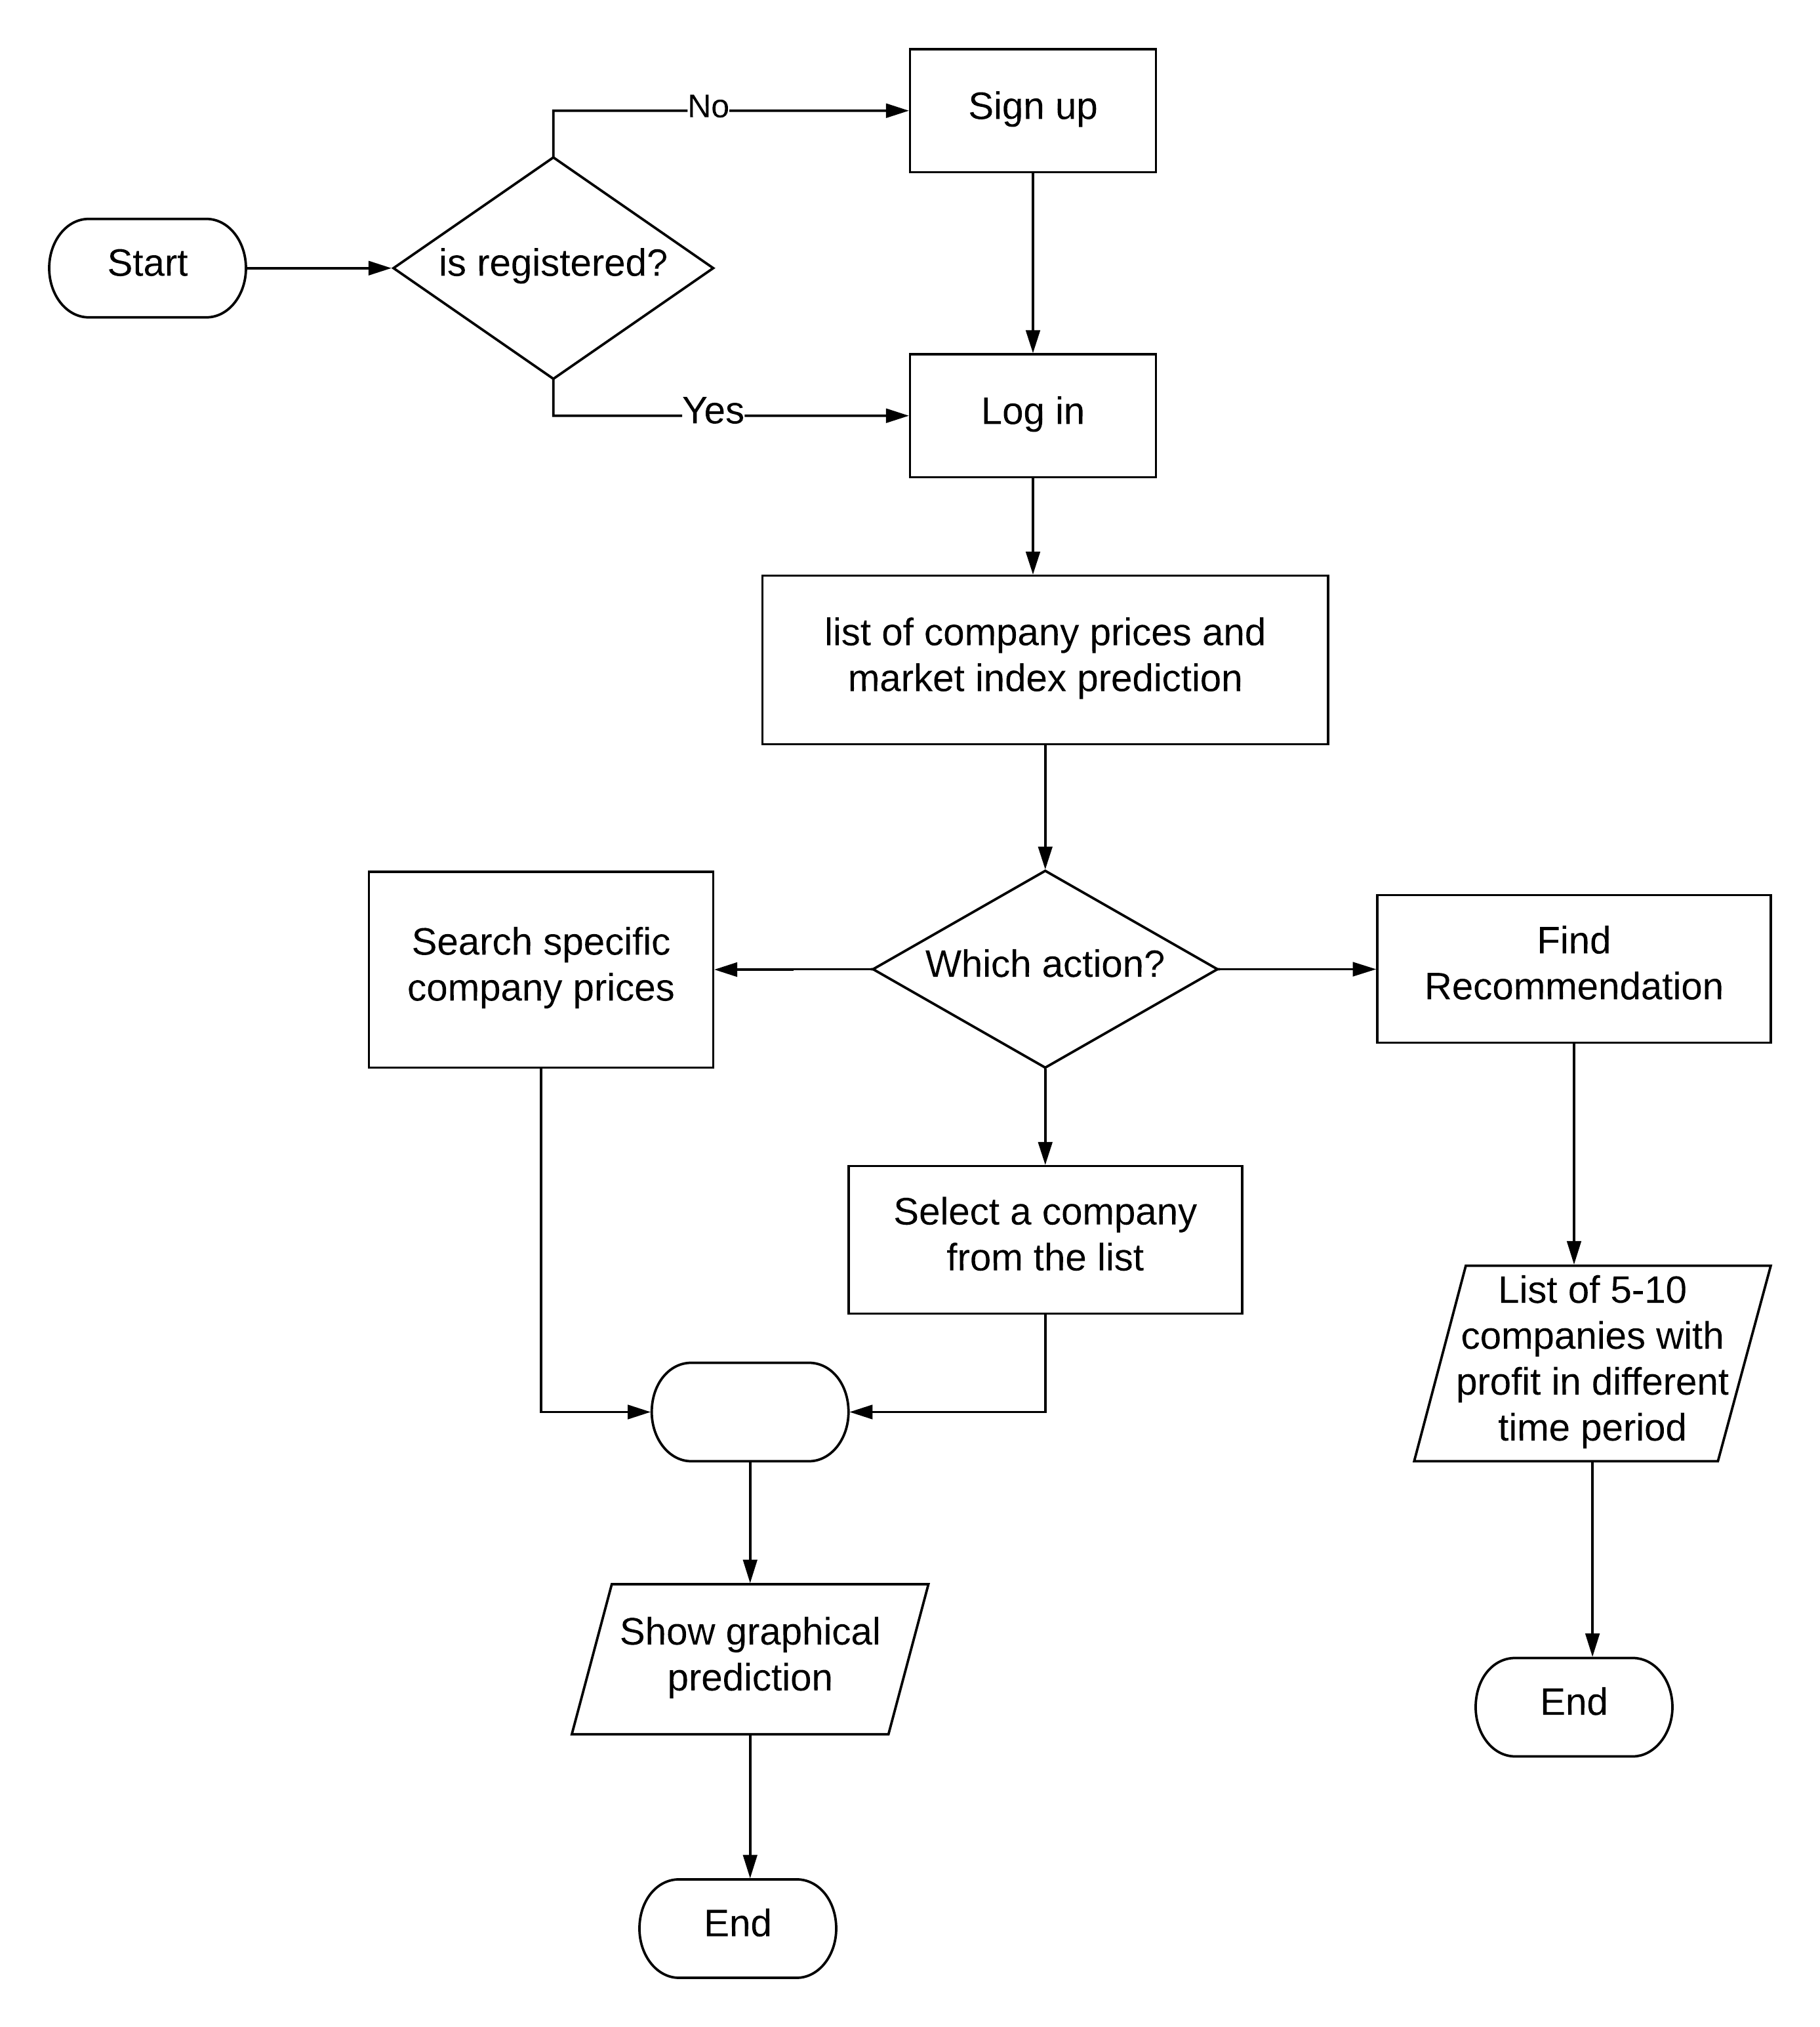
Maps

Slide 8

Requirement Specification
Calculate the predicted stock price by using machine learning algorithm
Recommend investment depending on buyer’s correct investment
Show the predicted price graphically using various charts
Show the market index to the user for their benefits.

Slide 9
Use-Case Diagram

Slide 10
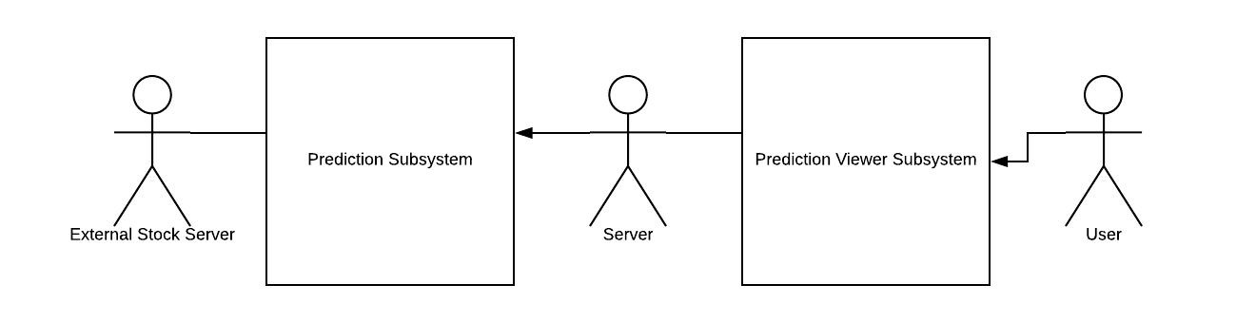
Overview of Systems

Slide 11
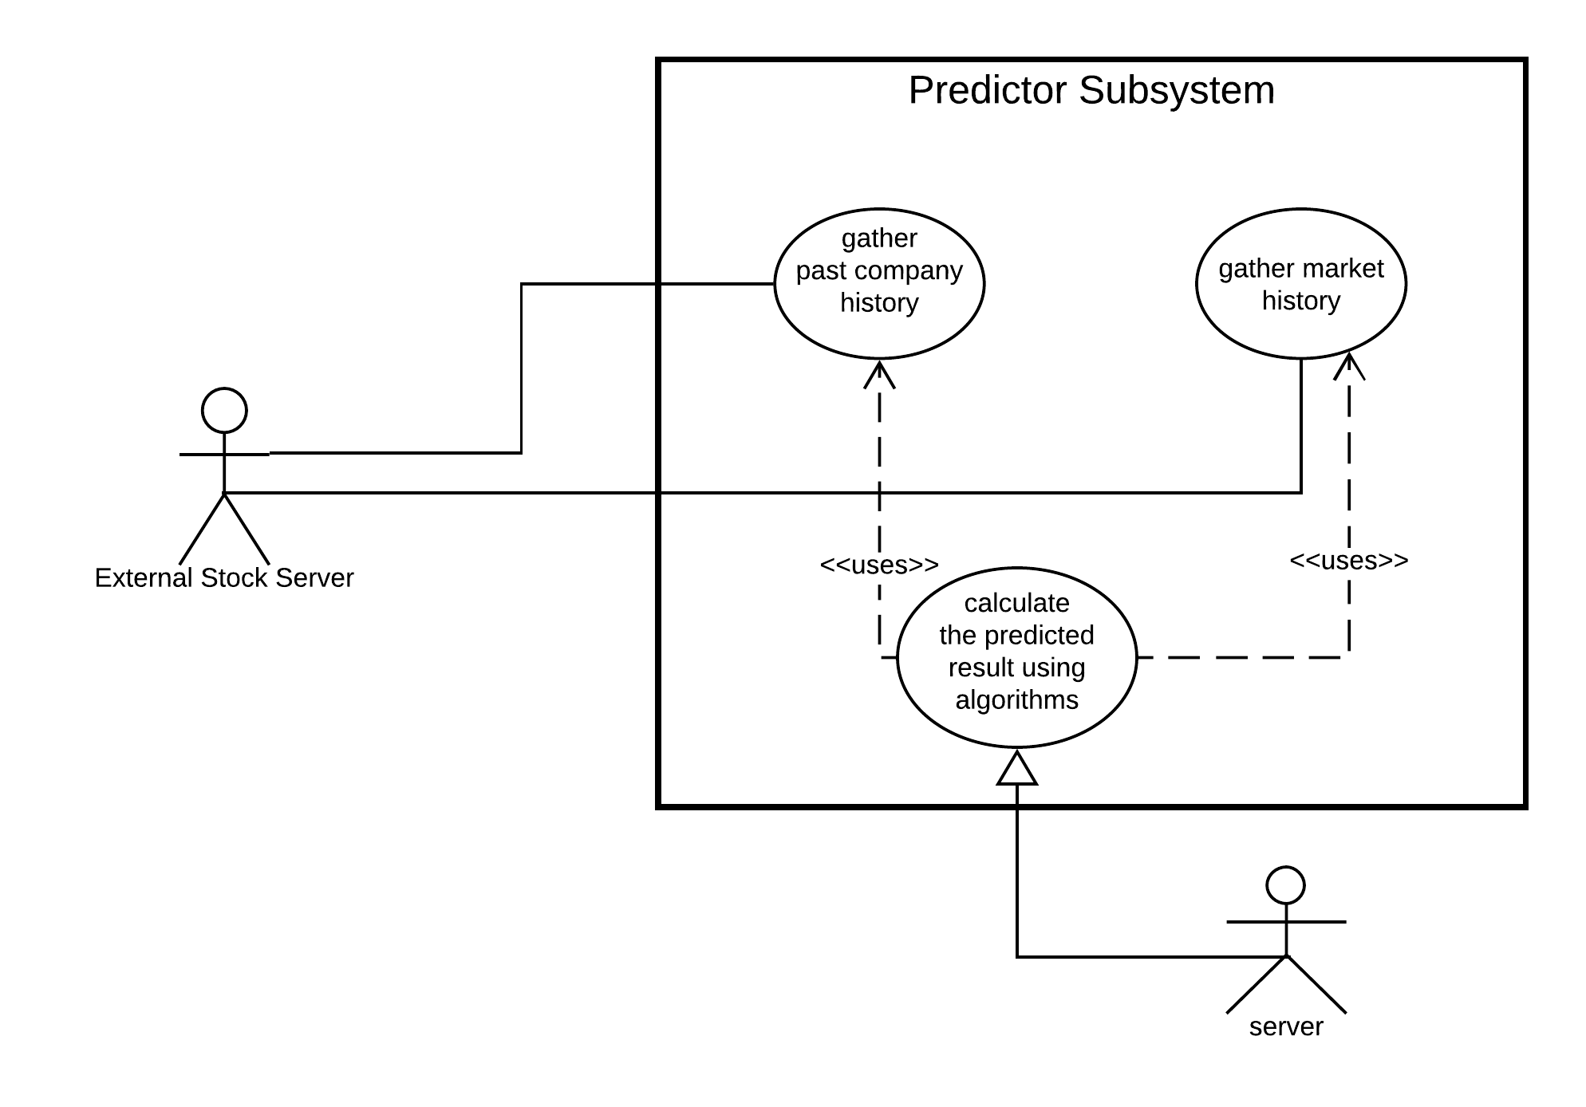
Predictor Sub-System

Slide 12
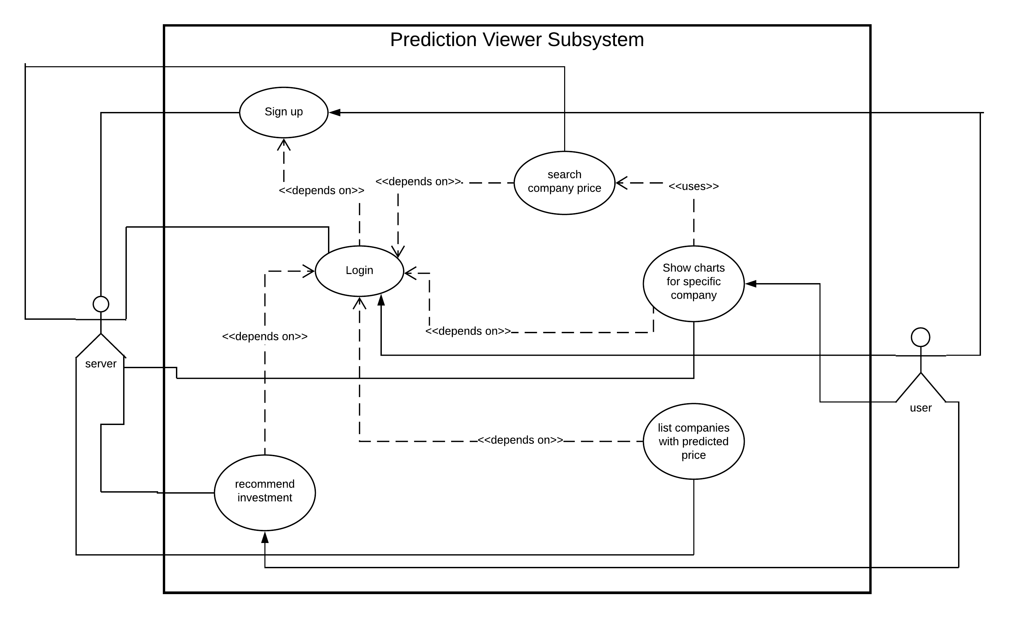
Prediction Viewer Sub-System

Slide 13
Thanks!
Any questions?

